Slide 1
EECS498-003
Formal Verification of Systems Software
Material and slides created by
Jon Howell and Manos Kapritsos

Slide 2
About me
Manos Kapritsos (manosk@umich.edu)
Areas of research: Formal Verification, Distributed Systems
29+1 years old (but I am not 30)
Disclaimer
Any resemblance to purple-looking super
villains, living or dead, is purely coincidental

Slide 3

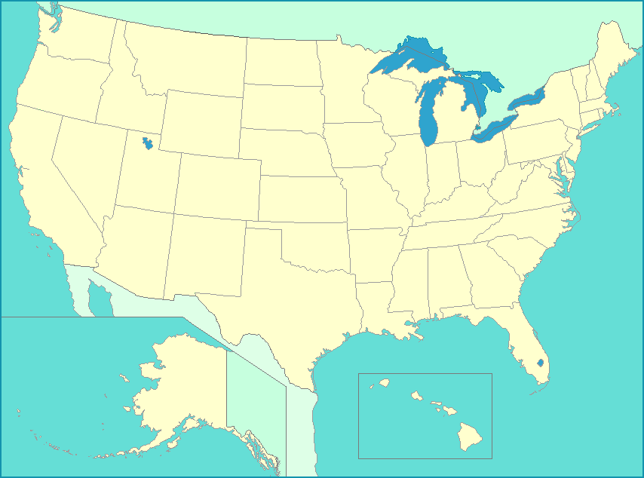

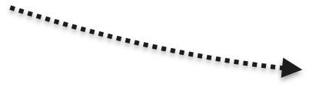
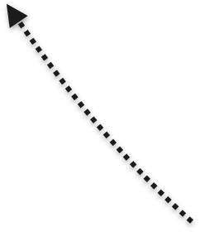


About me

Slide 4
About you and me
I love teaching and interacting with my students
I want to get to know you all by name

Slide 5
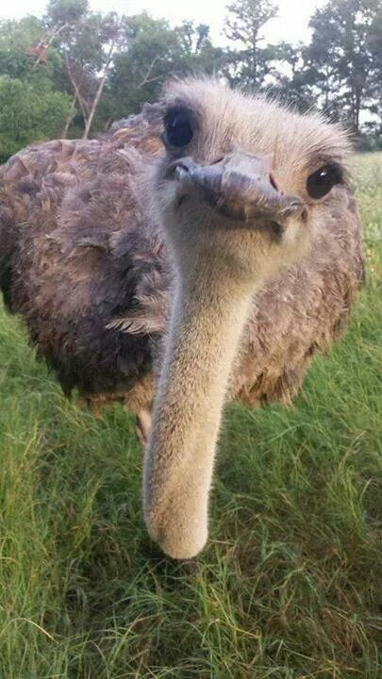
It’s picture time!
Give your phone to someone close to you
Pose for the picture
Go to verification.eecs.umich.edu/self.php
(login may be required)
Upload your picture!
(optional) update your preferred name

Slide 6
About you and me
I love teaching and interacting with my students
I want to get to know you all by name
I’m here to help. Come to me with any question!
  course-related: office hours
    Thursday, 11am-12pm, BBB 4824, starting next week
  Life, The University, and Everything: any time

Slide 7

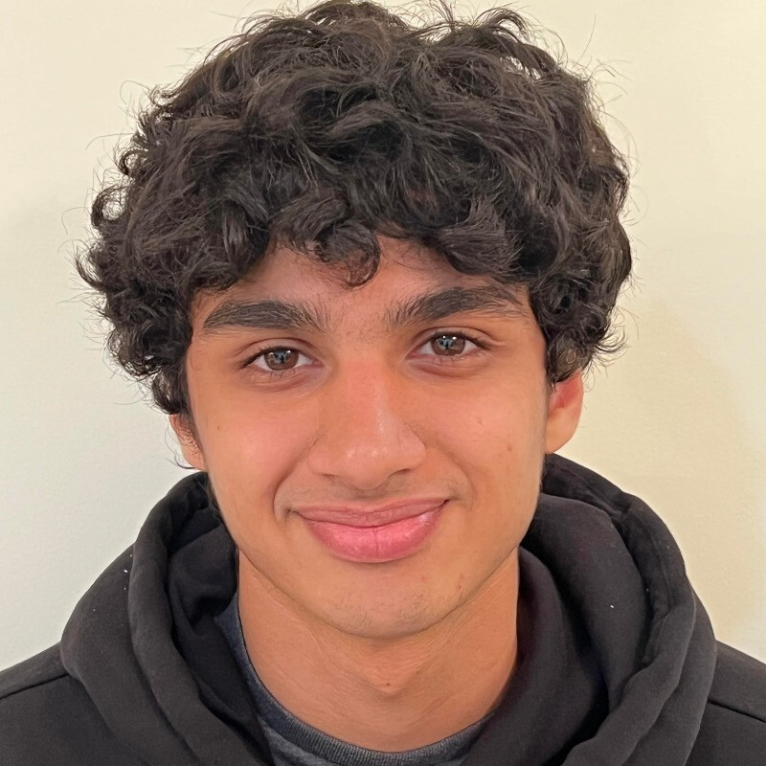
If you need more help...
Our GSI, Keshav Singh, is here to help
A Jedi Master in Formal Verification
Office hours: Monday 4:30-5:30, Learning Center Table #1

Slide 8

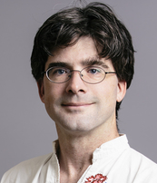
The unseen hero
Jon Howell, VMWare Research
Co-designer of the material in this course
“Bugs, unit tests, gdb. The dark side are they.”
“Testing not make one great.”

Slide 9
Agenda for Today
Why learn formal verification?
Course syllabus and logistics
What is formal verification?
  (and other, related approaches)
Getting started with Dafny

Slide 10
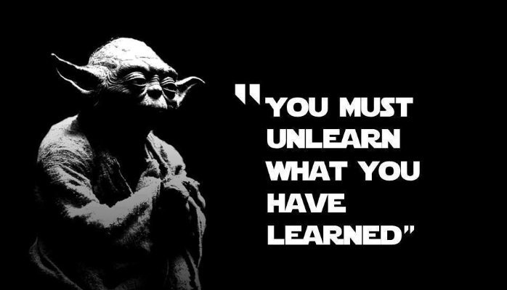
Why learn formal verification?
My research interests
EECS280/281
High-level programming
EECS482
OS-level programming
EECS491
Distributed programming
Scalability
Dependability
We have taught you how to write and test programs

Slide 11
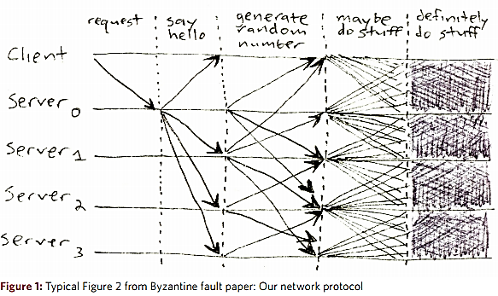
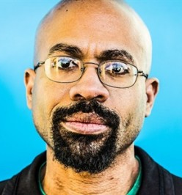
Real-world systems are too complex to test
My research interests
Scalability
Dependability
[Mickens 2013]

Slide 12

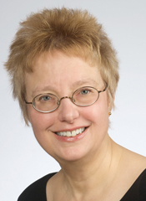
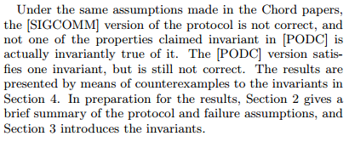
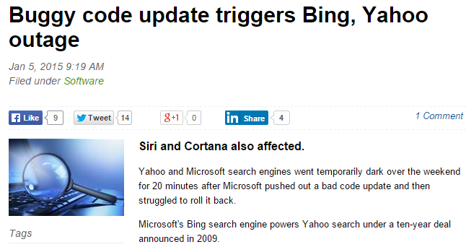
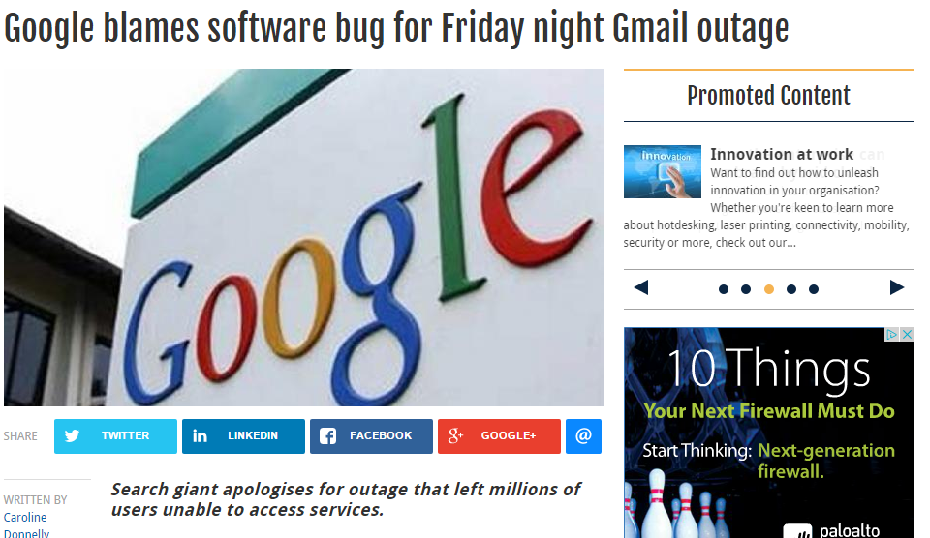
Despite tremendous effort...
My research interests
“not one of the properties claimed invariant in [PODC] is actually invariantly true of it.”
BUGS
Scalability
Dependability
[Zave 2015]

Slide 13
Is it possible to write code that is completely bug-free?
Formal verification is as close as we can get

Slide 14
March 25, 2015
(or how I became a believer)
One day before the deadline of SOSP’15, we had not yet run our code
...and yet our code ran correctly the first time we ran it!
  (and every time afterwards)

Slide 15
Verification in the real world
Verification is an increasingly popular approach
Many companies have picked it up in the last few years:
  Microsoft, Amazon, Facebook
  NASA, Boeing
  Many blockchain/fintech companies

Slide 16
How will you benefit from this class?
It will make you a better programmer
  Whether you end up writing verified code or not
You will learn to specify your code
  To express your intent clearly and unambiguously
  Just like design docs, but better
You will learn important concepts
  E.g. inductive invariants, refinement
Get ahead of the curve
  Learn an emerging skill

Slide 17
Testimonial from last semester
“I had a ~30 minute coding interview (in Python) and I didn't have a single runtime or compilation [error] after writing multiple class definitions ~100 lines of code. I have become a better programmer and approach problems in a more structured way because of this class and it was a large reason I got the position (as my interviewer has since told me).”
Anonymous student, Winter 2024

Slide 18
Objectives of this class
Understand the fundamentals of formal verification
Learn how they apply in a (distributed) systems context
Get hands-on experience with proving systems correct
Become familiar with a practical verification language

Slide 19
Prerequisites
Experience with programming
  i.e. EECS281
I will explain the mechanics of any distributed systems in the class for those of you that haven’t taken EECS491
No verification experience required
If anything is unclear, do not hesitate to ask

Slide 20

About this class
Disclaimer: this class is not formally verified!
This is the third time I am teaching this class
  …and the first class ever on this material
There is no textbook (anywhere!)
  Jon and I are currently writing one (based in part on the experience from this class)

Slide 21
Class material
Class webpage
  https://verification.eecs.umich.edu
Syllabus, lecture slides, problem sets and projects will be posted on the class webpage
Subscribe yourself to Piazza
  Announcements and class discussion

Slide 22
Enrollment
We should be able to accommodate up to 50 people
If you cannot enroll in the class for some reason, come talk to me

Slide 23
Lectures
Lectures will be held in person in DOW 2166
Recordings will be posted at:
https://leccap.engin.umich.edu/leccap/site/z15i8cyn7j0y6wsp2vm
(link is also on course web page and Piazza)
I will be posting slides of each lecture (shortly) before the lecture, in case you want to keep notes directly on the slides

Slide 24
Lectures schedule
Material is divided into six chapters, plus some advanced topics
  Chapters 1-4 (before midterm) cover the basic concepts of verification
    Basic verification and Dafny mechanics
    Specification
    Centralized state machines
    Proving properties and inductive invariants
  Chapters 5-6 (after midterm) cover distributed systems and refinement proofs
    Distributed state machines
    Refinement
    Advanced topics

Slide 25
Problem sets and projects
There are four (programming) problem sets and two projects
  Problem sets will be done individually
  Projects will be done in groups of 1-2 students
All deliverables will be submitted via the autograder.io website
  They use a combination of auto-grading and hand-grading

Slide 26
Class workload
var difficulty
if student.degree == undergraduate {
difficulty := “light to medium”
} else {
difficulty := “heavy”
}
print “This class is “+difficulty

Slide 27

Policies
Submission
  Three submissions per day to the autograder
  Due at midnight on deadline
  Three late days throughout the semester
Collaboration
  Okay to clarify problem or discuss Dafny syntax
  Not okay to discuss solutions

Slide 28
Exams
Midterm: October 17, 6-8pm
Final: December 18, 8-10am (sorry, the registrar sets this time!)
No makeup exams
  Except in dire circumstances
  Make sure you schedule your interviews appropriately

Slide 29
Grading breakdown
Problem sets: 26%
  PS1: 8% (Chapters 1 and 2)
  PS2: 6% (Chapters 3 and 4)
  PS3: 6% (Chapter 5)
  PS4: 6% (Chapter 6)
Projects: 30%
  Project 1: 15%
  Project 2: 15%
Midterm exam: 22%
Final exam: 22%

Slide 30
What is formal verification?
Step 1: Specify the correctness of the system formally
Step 2: Prove that the implementation conforms to the spec
If the spec expresses your correctness property, then your system is correct, subject to any assumptions you have made during your proof

Slide 31
Other approaches
Testing: run the system with a large and/or representative set of inputs to determine if it behaves correctly
  Quality depends on acumen of test designer
  Infeasible to achieve complete coverage for complex systems
Model checking: Model the system and ensure all possible states are safe
  Correctness depends on how accurate the model is
  Does not scale well to complex systems, especially those with infinite state spaces, like distributed systems

Slide 32
Statically checking for correctness
What we want is a “static correctness check”, akin to a static type check
You write your code normally, but if you introduce bugs the checker will tell you
When the checker complains, you have to spend some time to convince it that your code is right---if indeed it is

Slide 33
Using a Theorem Prover
Express the execution of the system and its correctness as a mathematical formula (done automatically by the language)
Give the formula to a theorem prover, effectively asking:
”If the system behaves this way, is it possible for its correctness to be violated?”
A negative answer means the system is proven to be correct
A positive answer means there is still work to do, either:
  the system is indeed incorrect
  the proof is incomplete

Slide 34

Using Dafny
We will be using Dafny as our verification language
      Dafny is an imperative language designed with formal verification in mind
        ...and plenty of functional language features
      Dafny uses an SMT solver (Z3) to automate verification to a large degree
        ...but it needs our help sometimes
      Most of the high-level skills are transferrable...
  ...but some are specific to Dafny and/or automation

Slide 35
Getting started with Dafny
In the lab on Friday, Keshav will go over instructions for installing Dafny 4.4
The simplest way to use Dafny is via the Visual Studio plugin
  Gives you a nice interface
You can also invoke Dafny on the command line:
  dafny myFile.dfy

Slide 36

Dafny in Docker
We provide you with a Docker container that has Dafny pre-installed
  Makes it easy to get started
  Ensures everyone is using the same Dafny version as the autograder
  Not highly recommended for the bulk of your development
Download and run it like this:
  docker pull ekaprits/eecs498-009:latest
  docker container run --mount src=$PWD,target=/home/autograder/working_dir,type=bind,readonly -t -i ekaprits/eecs498-009:latest
CAEN machines have some partial support for Docker
  If you don’t have access to a machine that can run Docker, contact me ASAP

Slide 37
Things to do
Browse the course web page
Subscribe to Piazza
Install Dafny 4.4 (during lab)
  If that doesn’t work: install Docker, pull image, run image

